Slide 1

UNT College of Music Graduate Orientation
Fall 2025

Slide 2

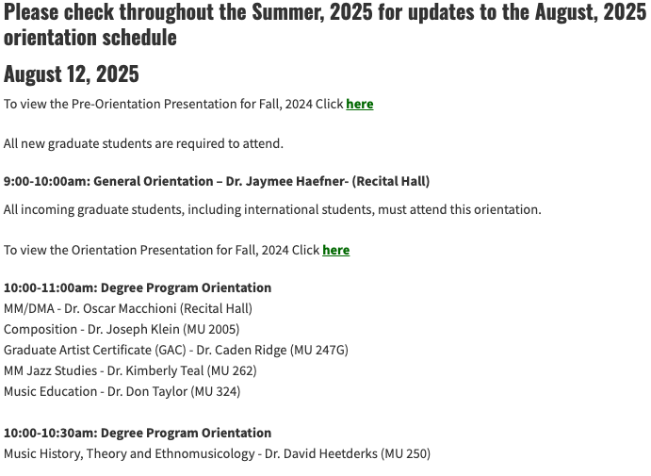
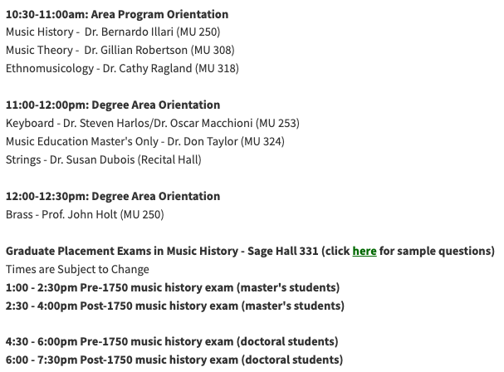

Slide 3
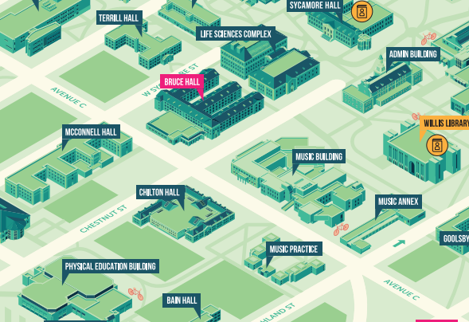
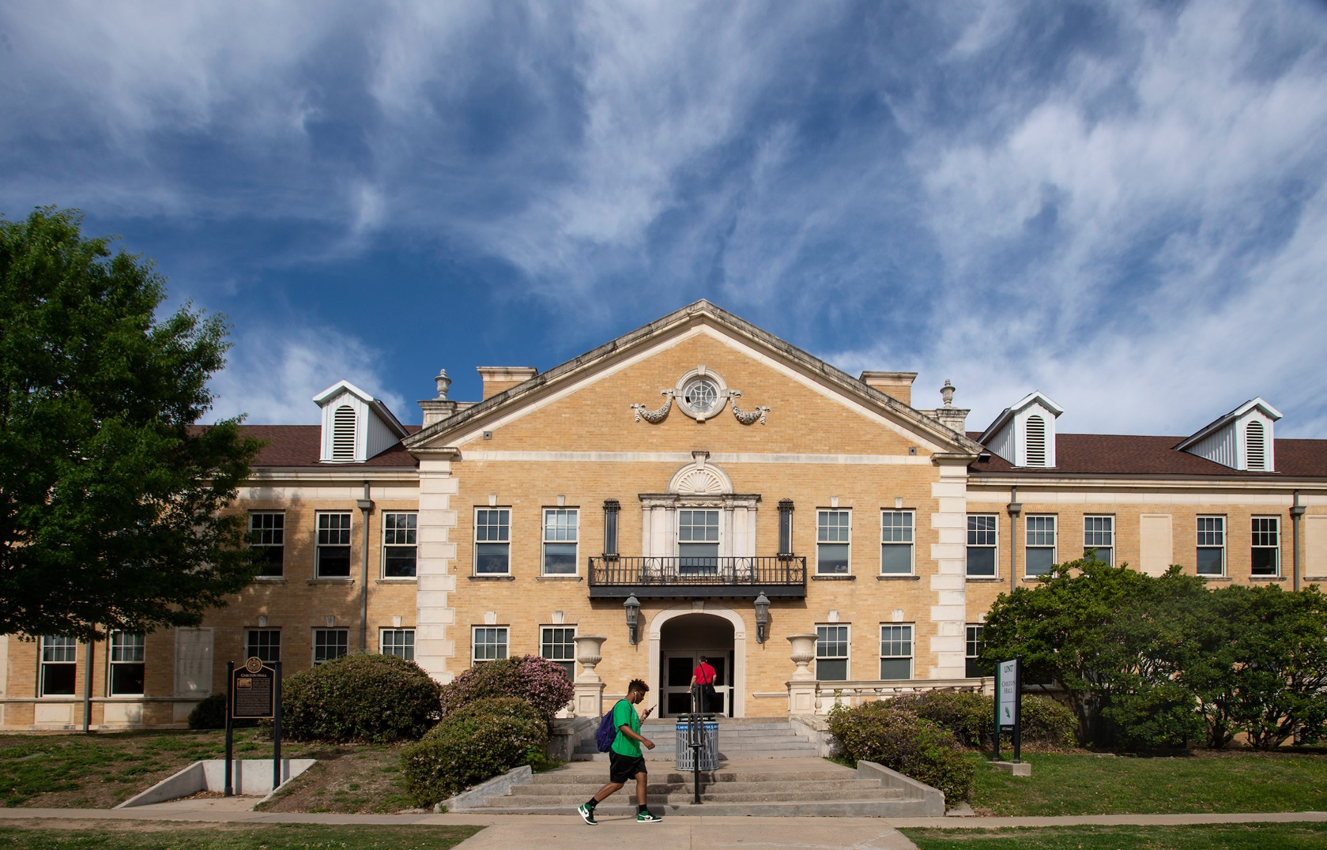
Graduate Studies Office
Located in Chilton Hall 211 (across from Main Music Building)

Slide 4

Contact Us
1
2
3
4
Website
music.unt.edu/graduate-studies
E-mail
music.grad@unt.edu
Grad Studies Office
Dr. Jaymee Haefner, Director of Graduate Studies
Dr. Colleen Conlon, Senior Graduate Academic Counselor
Dr. Caden Ridge, Graduate Academic Counselor
Katy Kinard, Administrative Coordinator for Scholarships & Awards
Reminder
Graduate students must use their UNT email address for all UNT-related correspondence.

Slide 5

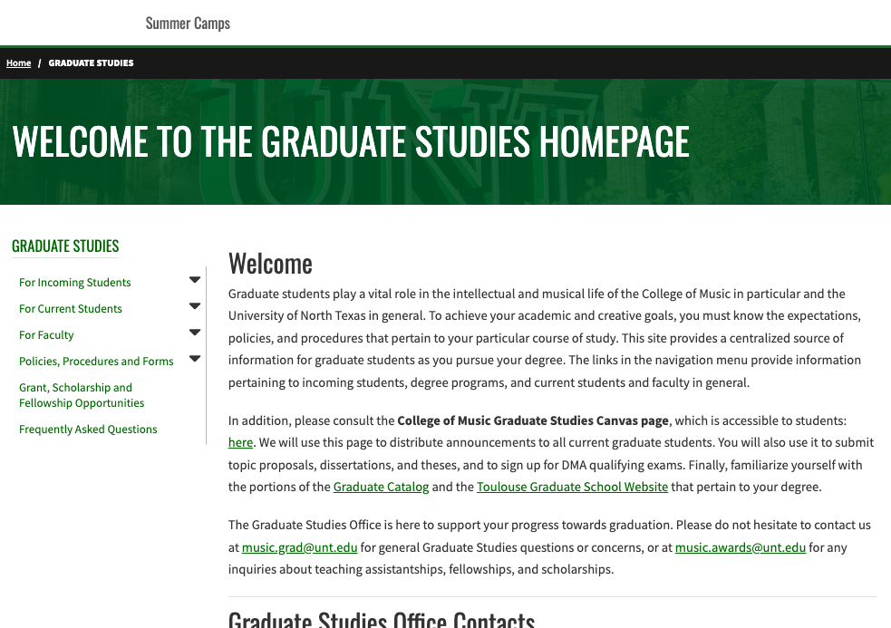
Our Homepage
The Graduate Studies website hosts a variety of useful information and resources such as handbooks, degree plans, polices, procedures, forms, and more.

Slide 6
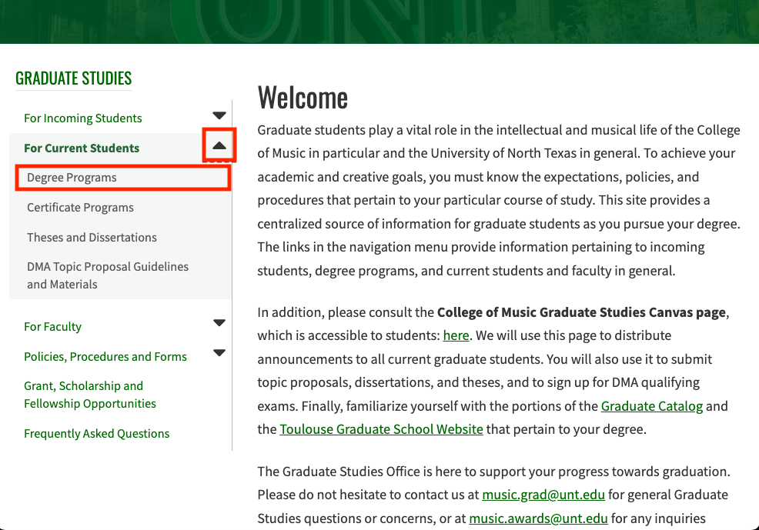
Finding you degree plan and handbook…
From the Grad Studies Homepage, select “For Current Students” then “Degree Programs”

Slide 7
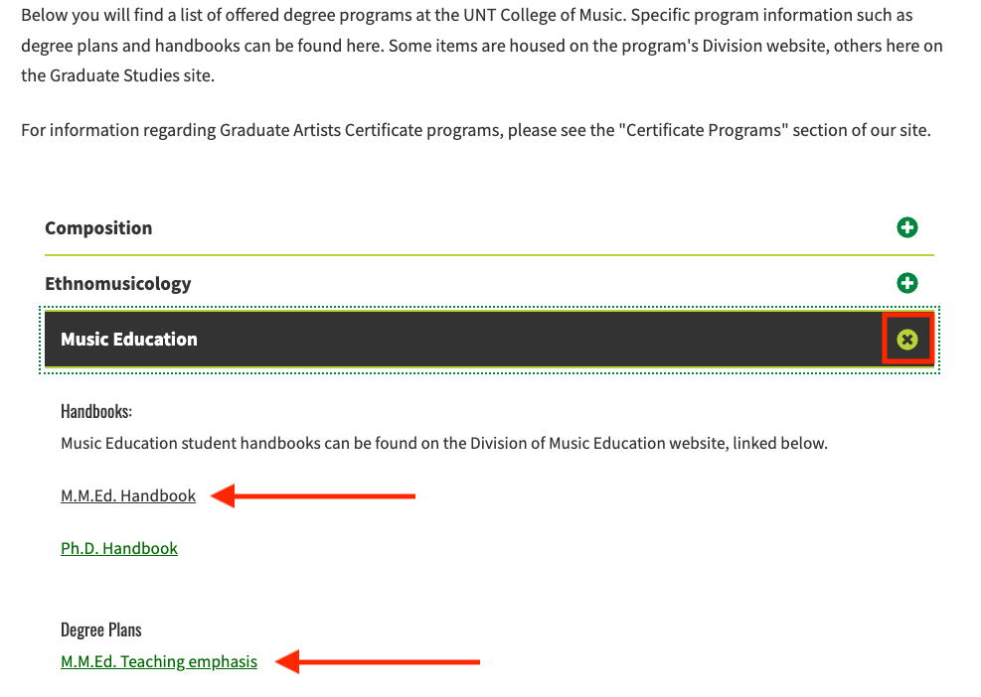
Selecting your degree plan…
Select your degree plan from the drop-down menu. Your degree plan and handbook will be there.

Slide 8
Forms
Degree Plans and Committee Forms
1
2
3
4
A signed contract filed in consultation with your major professor and related field professor.
Identifies all the courses you will take to fulfill your degree requirements.
You are bound to the catalog in effect when you file your degree plan, not the semester you start your degree.
File with your Advisory Committee before finishing your second semester of graduate study.

Slide 9

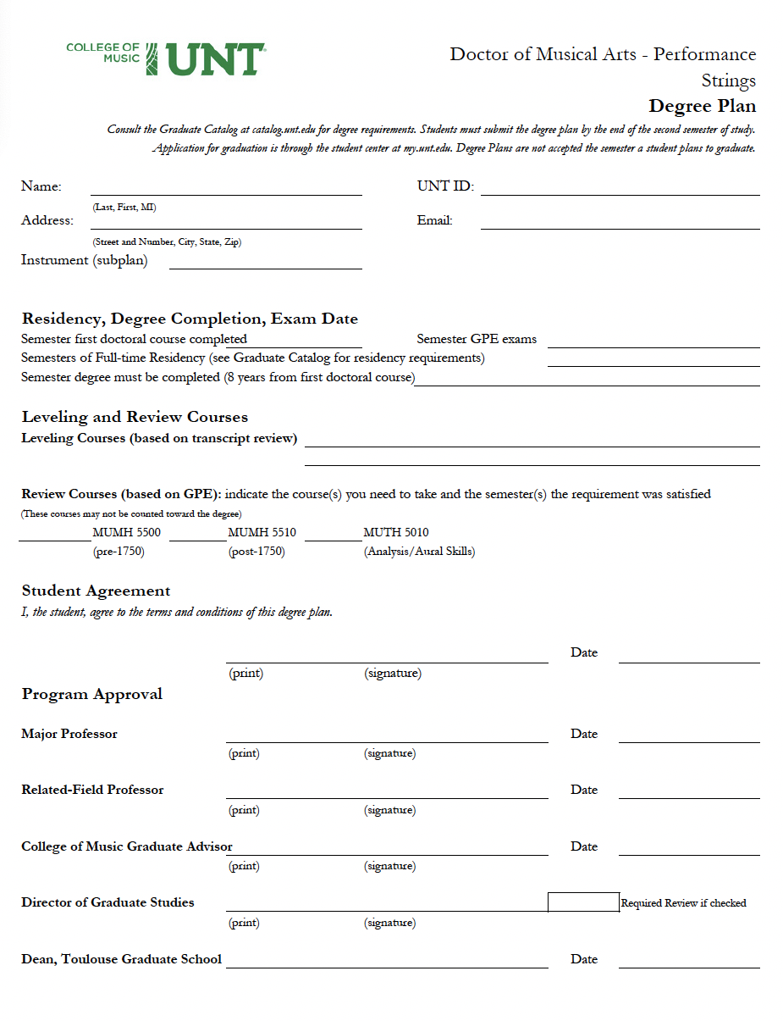
Example of Degree Plan (front)
1
Student information goes here
2
Required review courses are listed here
3
Signatures from you, your Major Professor, your Related Field Professor (if applicable), and a Graduate Advisor are required before filing with the Toulouse Graduate School.

Slide 10
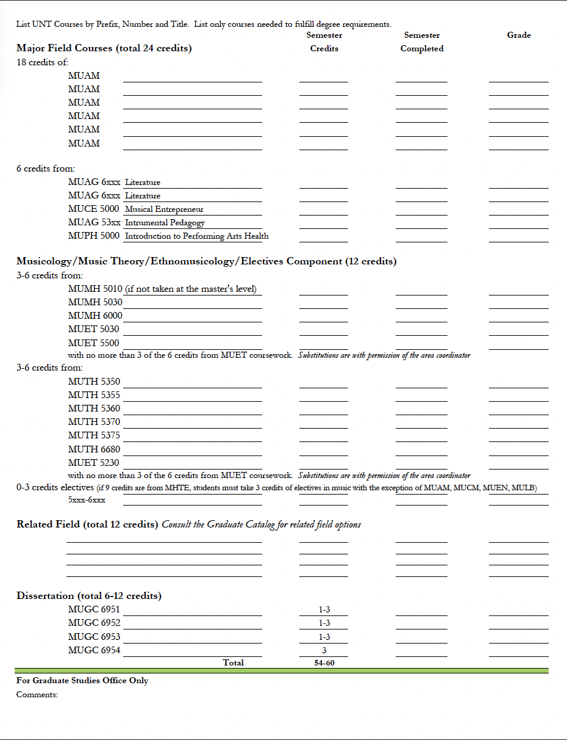
Example of Degree Plan (back)
1
Major Field Section
2
MUMH/MUTH/Elective Section
3
Related Field/Dissertation Hours Section

Slide 11
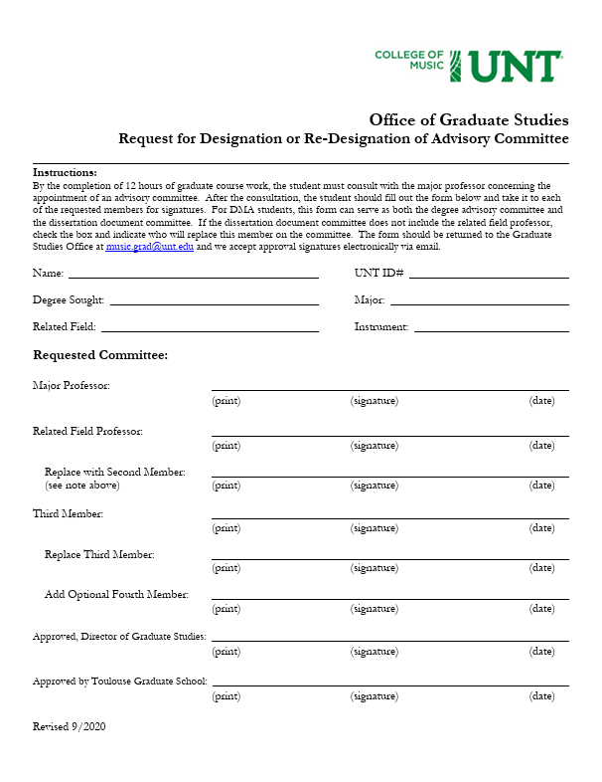
Committee Designation Form
1
To be completed at the end of your second semester of coursework
2
Signed by all members of your Advisory Committee
3
Three members are required, a fourth member is optional

Slide 12
Other Websites to Know
1
2
3
4
Graduate Catalog and Schedule of Classes
catalog.unt.edu – click “graduate” in the dropdown menu
registrar.unt.edu
Canvas
canvas.unt.edu
Toulouse Graduate School
tgs.unt.edu
Student Resources
music.unt.edu/resources

Slide 13

Leveling vs.
Review Courses

Slide 14

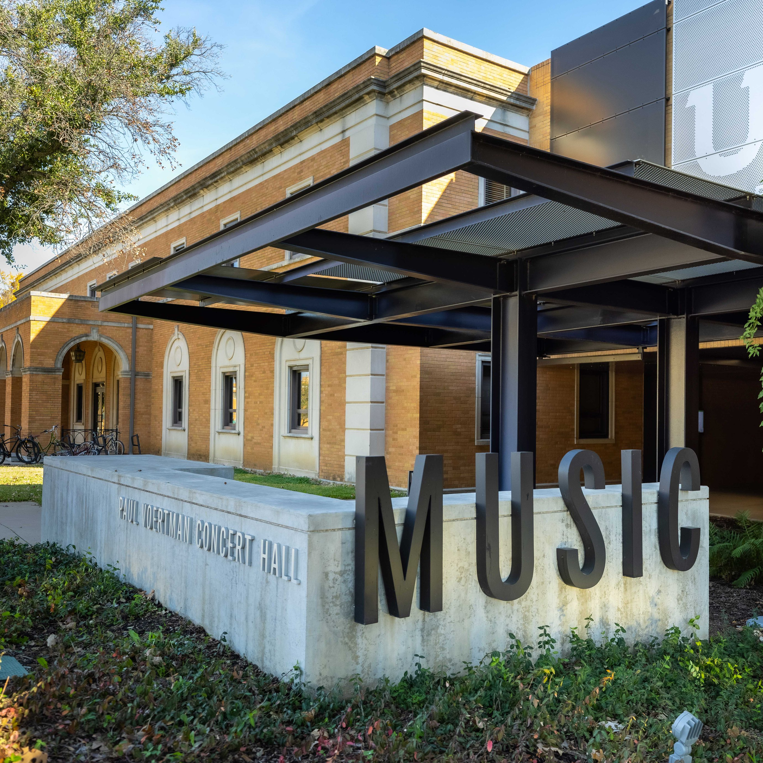
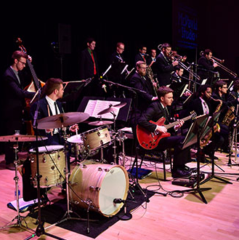
Leveling Courses
1
Determined by the coordinator of your major area based on transcript review.
2
Courses may or may not be applied to your degree plan, depending on your area and major degree program.

Slide 15
Review Courses
1
2
3
4
Required review courses are determined by the results of your exams. You were sent a transcript evaluation letter from music.grad@unt.edu with a list of exams you must take.
Grades are posted in Canvas by Thursday at noon. Please do not inquire before this time. Please ensure that you are in the GPE Graduate Center Canvas course. No retakes are allowed.
The GPE Graduate Center includes a guide to interpreting your test scores.
Review Courses cannot be applied towards your degree plan.
You must take review courses the first time they are offered, as they are a barrier to taking other courses in your degree. A grade of B or better is required.
The GWE (graduate writing exam) is no longer required.

Slide 16

Related Field
Start thinking about a related field now and discuss with your major professor.
You must select one by the end of your first year.
Know whether you related field of choice has admissions criteria, e.g., an audition, application, etc.
Seek out a potential related field professor early.

Slide 17
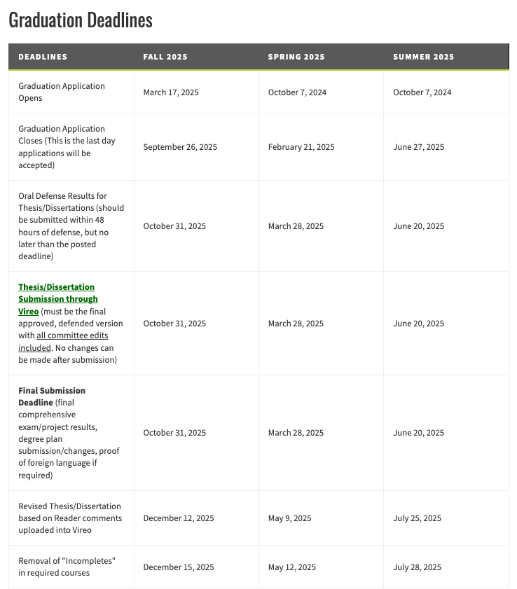
Degree Milestones
tgs.unt.edu/new-current-students/graduation-information
1
Remember to apply to graduate by the posted deadline.
2
CoM Thesis/Dissertation deadlines are two week prior to the posted TGS ones.
3
Master’s comprehensive oral exam results are due halfway though the semester. Make sure to plan accordingly!

Slide 18
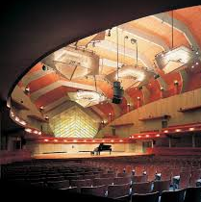
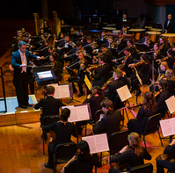
Degree Time Limits
Masters
  5 Years
Doctoral
  8 Years

Slide 19
Tips for Success
1
2
3
4
Use your full legal name (not a nickname) on all official University paperwork.
Use your EagleConnect email address when communicating with UNT faculty and staff.
Include your 8-digit student ID number in any correspondence with the Graduate Studies Office.
Address faculty and staff by their titles (Dr. or Prof.) unless they invite you to do otherwise.

Slide 20
More Tips for Success…
Ignore rumors. What applies to your friends might not apply to you.
Read the catalog and handbooks. Schedule advising appointments regularly to stay on track.
Follow the announcements page in Canvas and be aware of all registration and payment deadlines.
It is your responsibility to know all deadlines, including those for final degree milestones.
Use the university resources; UNT Writing Lab, Student Wellness Center, etc. Your student fees pay for this support.
First, research your question on our website. Then, reach out.

Slide 21
Academic Integrity and Honesty
Academic dishonestly: An act or instance of using/copying or closely imitating the language and thoughts of another author without proper citation/credit.
UNT has a zero-tolerance policy for academic dishonesty.
Use citations and be familiar with “fair use” for musical examples. Quick reference guide here: https://guides.library.unt.edu/SCCopyright/fairuse
Use iThenticate to check your work. Always review your writing for missing citations.
Student FAQ: https://vpaa.unt.edu/ss/integrity/faq-students
If you’re unsure, ask a faculty member.

Slide 22
Questions?
We want you to be successful! When in doubt, reach out to our advisors or faculty for help.
Graduate Studies FAQ page

